Slide 1
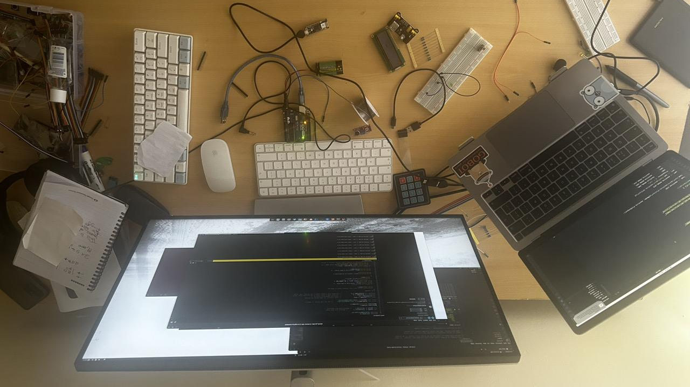
Gophercon

Slide 2
Hi It's
Marvin Hosea
Software Engineer @Scaratec Gmbh
I have been involved in the integration and implementation of Integrated Customs Management System (iCMS) for Sea and Air import championed by Kenya Revenue Authority (KRA)
Gophers Africa And Nairobi Gophers Co-organizer

Slide 3
Saving Africa Savannah Wildlife With Go MQTT
GopherCon 9 July 2024

Slide 4
Let's Manage Expectations
What I will talk about
The Elephant in The Room
Go MQTT Overview
Challenges and Implementation
Closing Remarks

Slide 5






Questions?
@marvin_hosea

Slide 6
Intro

Slide 7
The Elephant in The Room
Wildlife Poaching
Illegal trafficking and killing of animals
Notes:
v v

Slide 8

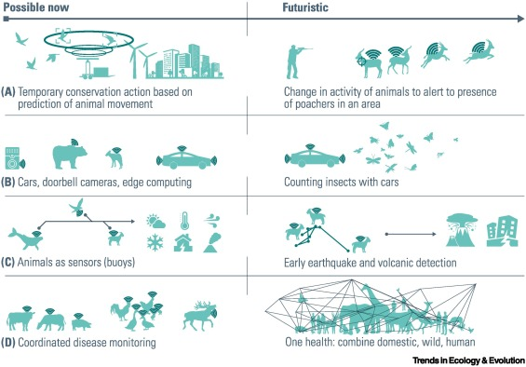

Slide 9

Kenya Stats
1970 - 1980s: 170,000 Elephants
1979 - 2000: 16,000 Elephants | Ivory Demand
Source KWS

Slide 10
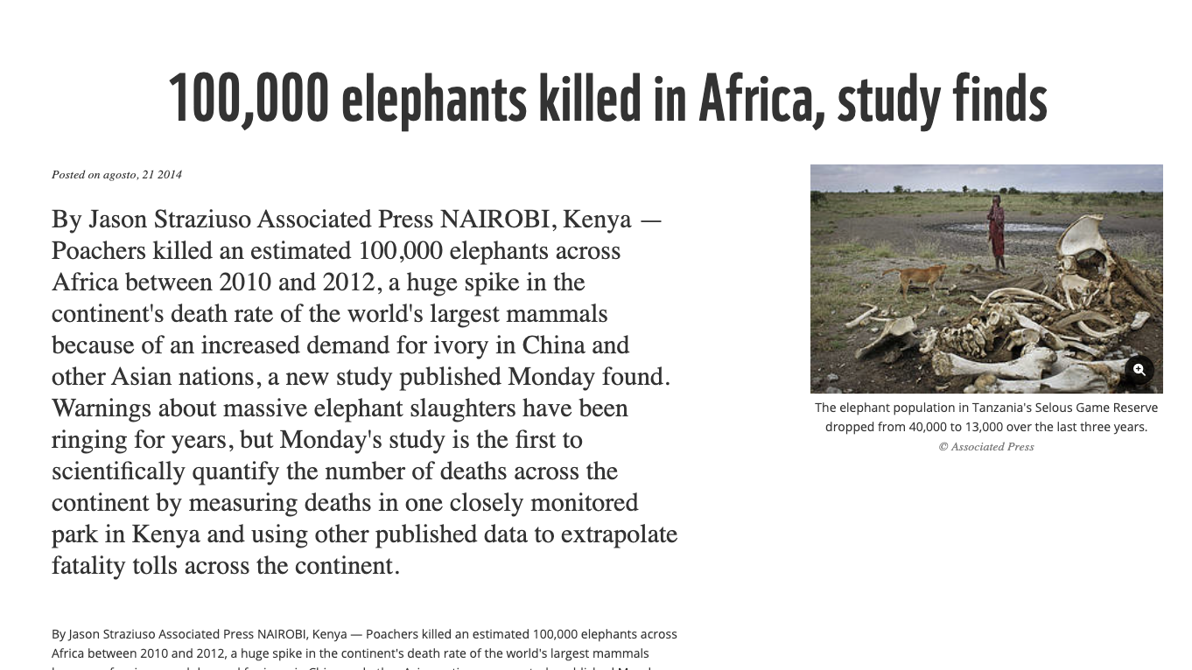

Slide 11
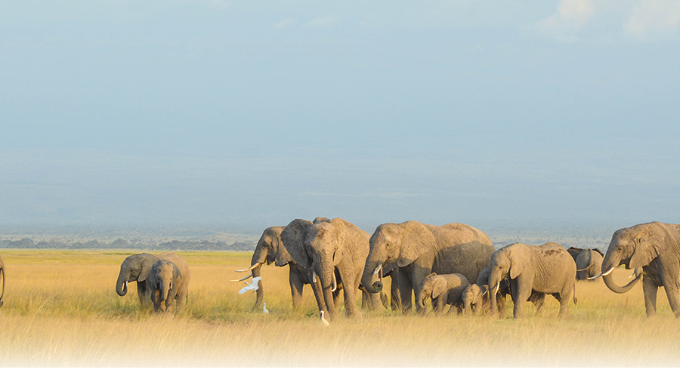
Impact
Formation of Kenya Wildlife Service
Africa Elephant is listed in Appendix I
World Elephant Day: 12th August
World Anti-poaching Systems and Stragies Improvement

Slide 12
Anti-poaching

Slide 13
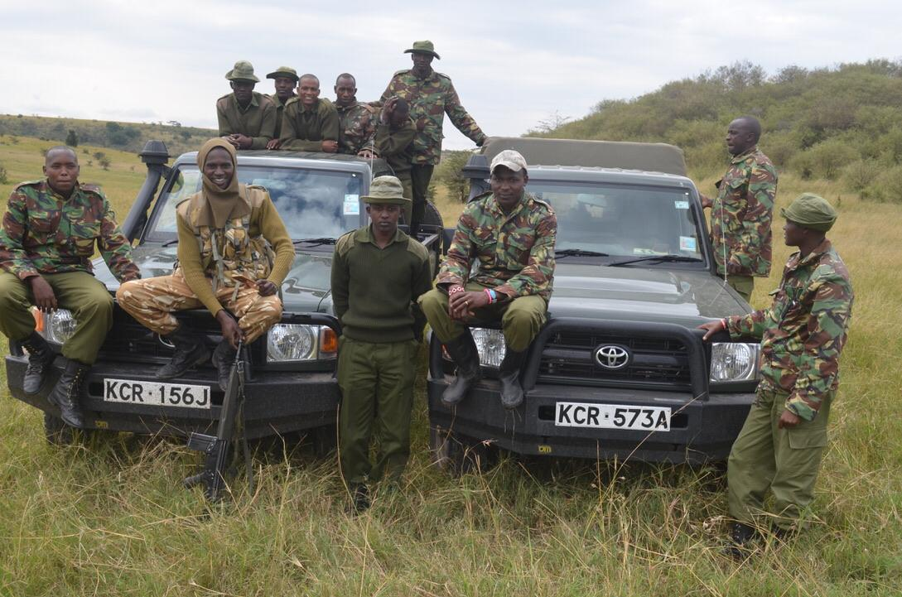
Anti-poarching stragegies
Patrols and Rangers
Provide necessary training, and Equipment for locals to combat poaching
Label
Label
Source MEPs

Slide 14
Anti-poarching stragegies
Patrols and Rangers
Provide necessary training, and Equipment for locals to combat poaching
Surveillance
Cameras to monitor wildlife and detect poachers

Slide 15

Kenya Stats
1970 - 1980s: 170,000 Elephants
1979 - 1990: 16,000 Elephants | Ivory Demand
Current population: Approx 36,000 Elephants
Source KWS
36,000

Slide 16
technology

Slide 17
Anti-poarching stragegies
Patrols and Rangers
Provide necessary training, and Equipment for locals to combat poaching
Surveillance
Cameras to monitor wildlife and detect poachers
Technology
GPS tracking: Using devices to track wildlife movements with Geo fancing
Big data: Analyzing large datasets to predict poaching hotspots and patterns

Slide 18
Patrols and Rangers
Provide necessary training, and Equipment for locals to combat poaching
Surveillance
Cameras to monitor wildlife and detect poachers
Technology
GPS tracking: Using devices to track wildlife movements
Big data: Analyzing large datasets to predict poaching hotspots and patterns
IT
Information Technology
OT
Operational Technology

Slide 19
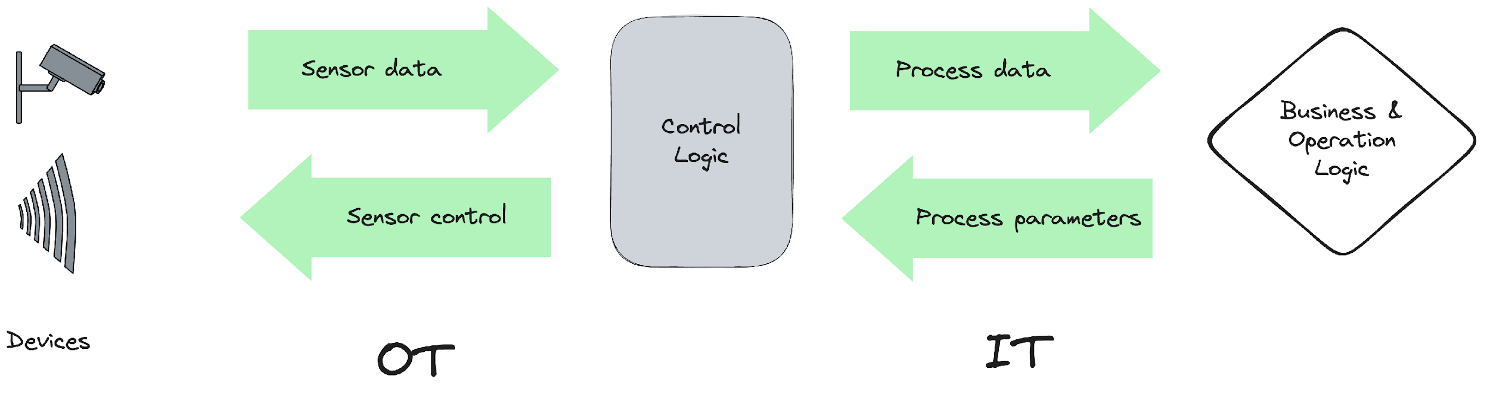

Slide 20

Patrols and Rangers
Provide necessary training, and equipment for locals to combat poaching.
Surveillance
Cameras to monitor wildlife and detect poachers
Technology
GPS tracking: Using devices to track wildlife movements
Big data: Analyzing large datasets to predict poaching hotspots and patterns
IT
Information Technology
OT
Operational Technology

Slide 21
Challenge
Expensive cost of internet bundles
Unreliable internet within the Savannah region
Reduce cost of anti-poaching operations

Slide 22


Slide 23
Choosing The Right Technology For The Job

Slide 24
System Requirement
Low bandwidth and high latency environments
Distribute minimal data in huge volumes
Work with constrained devices (microcontollers)
Highly scalable
Secure
Use Go

Slide 25


Slide 26
WHAT IS MQTT?
Message Queuing Telemetry Support
MQTT is a lightweight, publish-subscribe based binary messaging protocol designed for resource-constrained devices and low-bandwidth, high-latency, or unreliable networks.
Minimal resources consumption
Low bandwidth and high-latency environment
Bi-directional
Easy to implement: 15 protocol command
Has a fixed 2 byte over-the-wire overhead header
Has a max 256MB payload
Runs on top of TCP/TLS/WS/WSS stacks

Slide 27
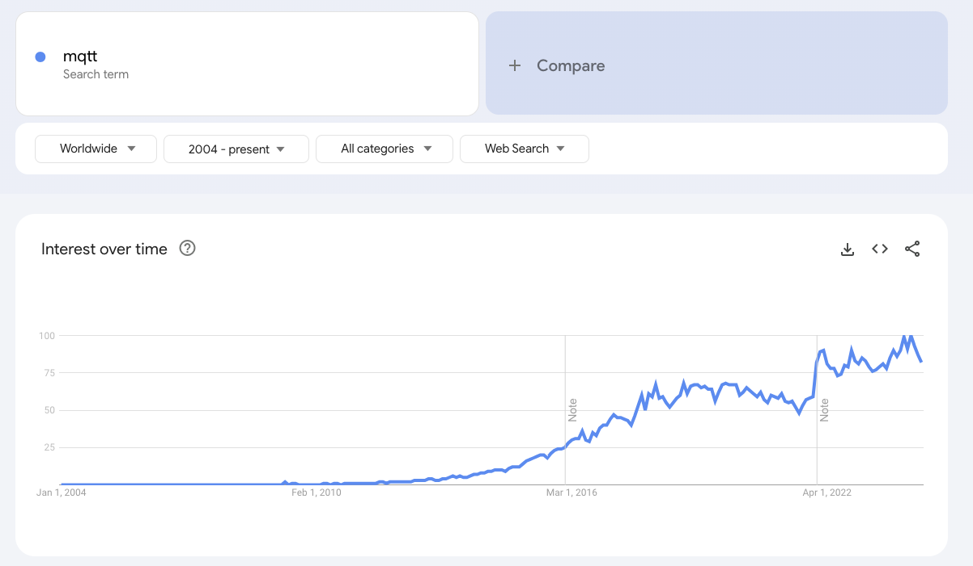

Slide 28
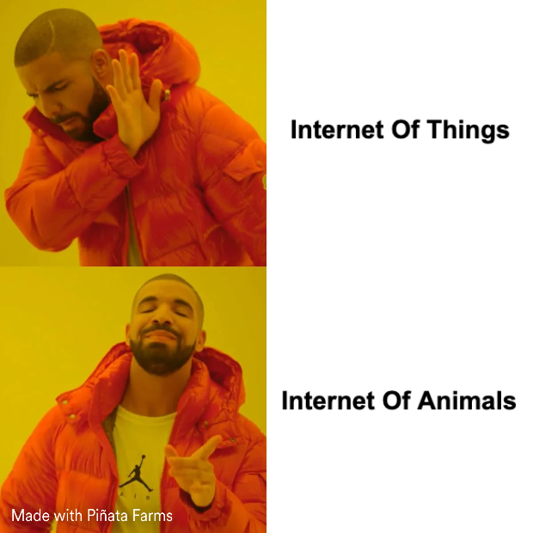

Slide 29
Application of MQTT
Remote sensing
Smart Cities/Homes
Wearables
Car Monitoring
Livestock management

Slide 30
MQTT Flow

Slide 31
MQTT Flow
Client initiate a connection to the broker

Slide 32
MQTT Flow
Client initiate a connection to the broker
Client either subscribe or publish a message to a topic

Slide 33
MQTT Flow
Client initiate a connection to the broker
Client either subscribe or publish a message to a topic
Broker receives published message and forward them to all clients subscribed to relevant topics

Slide 34
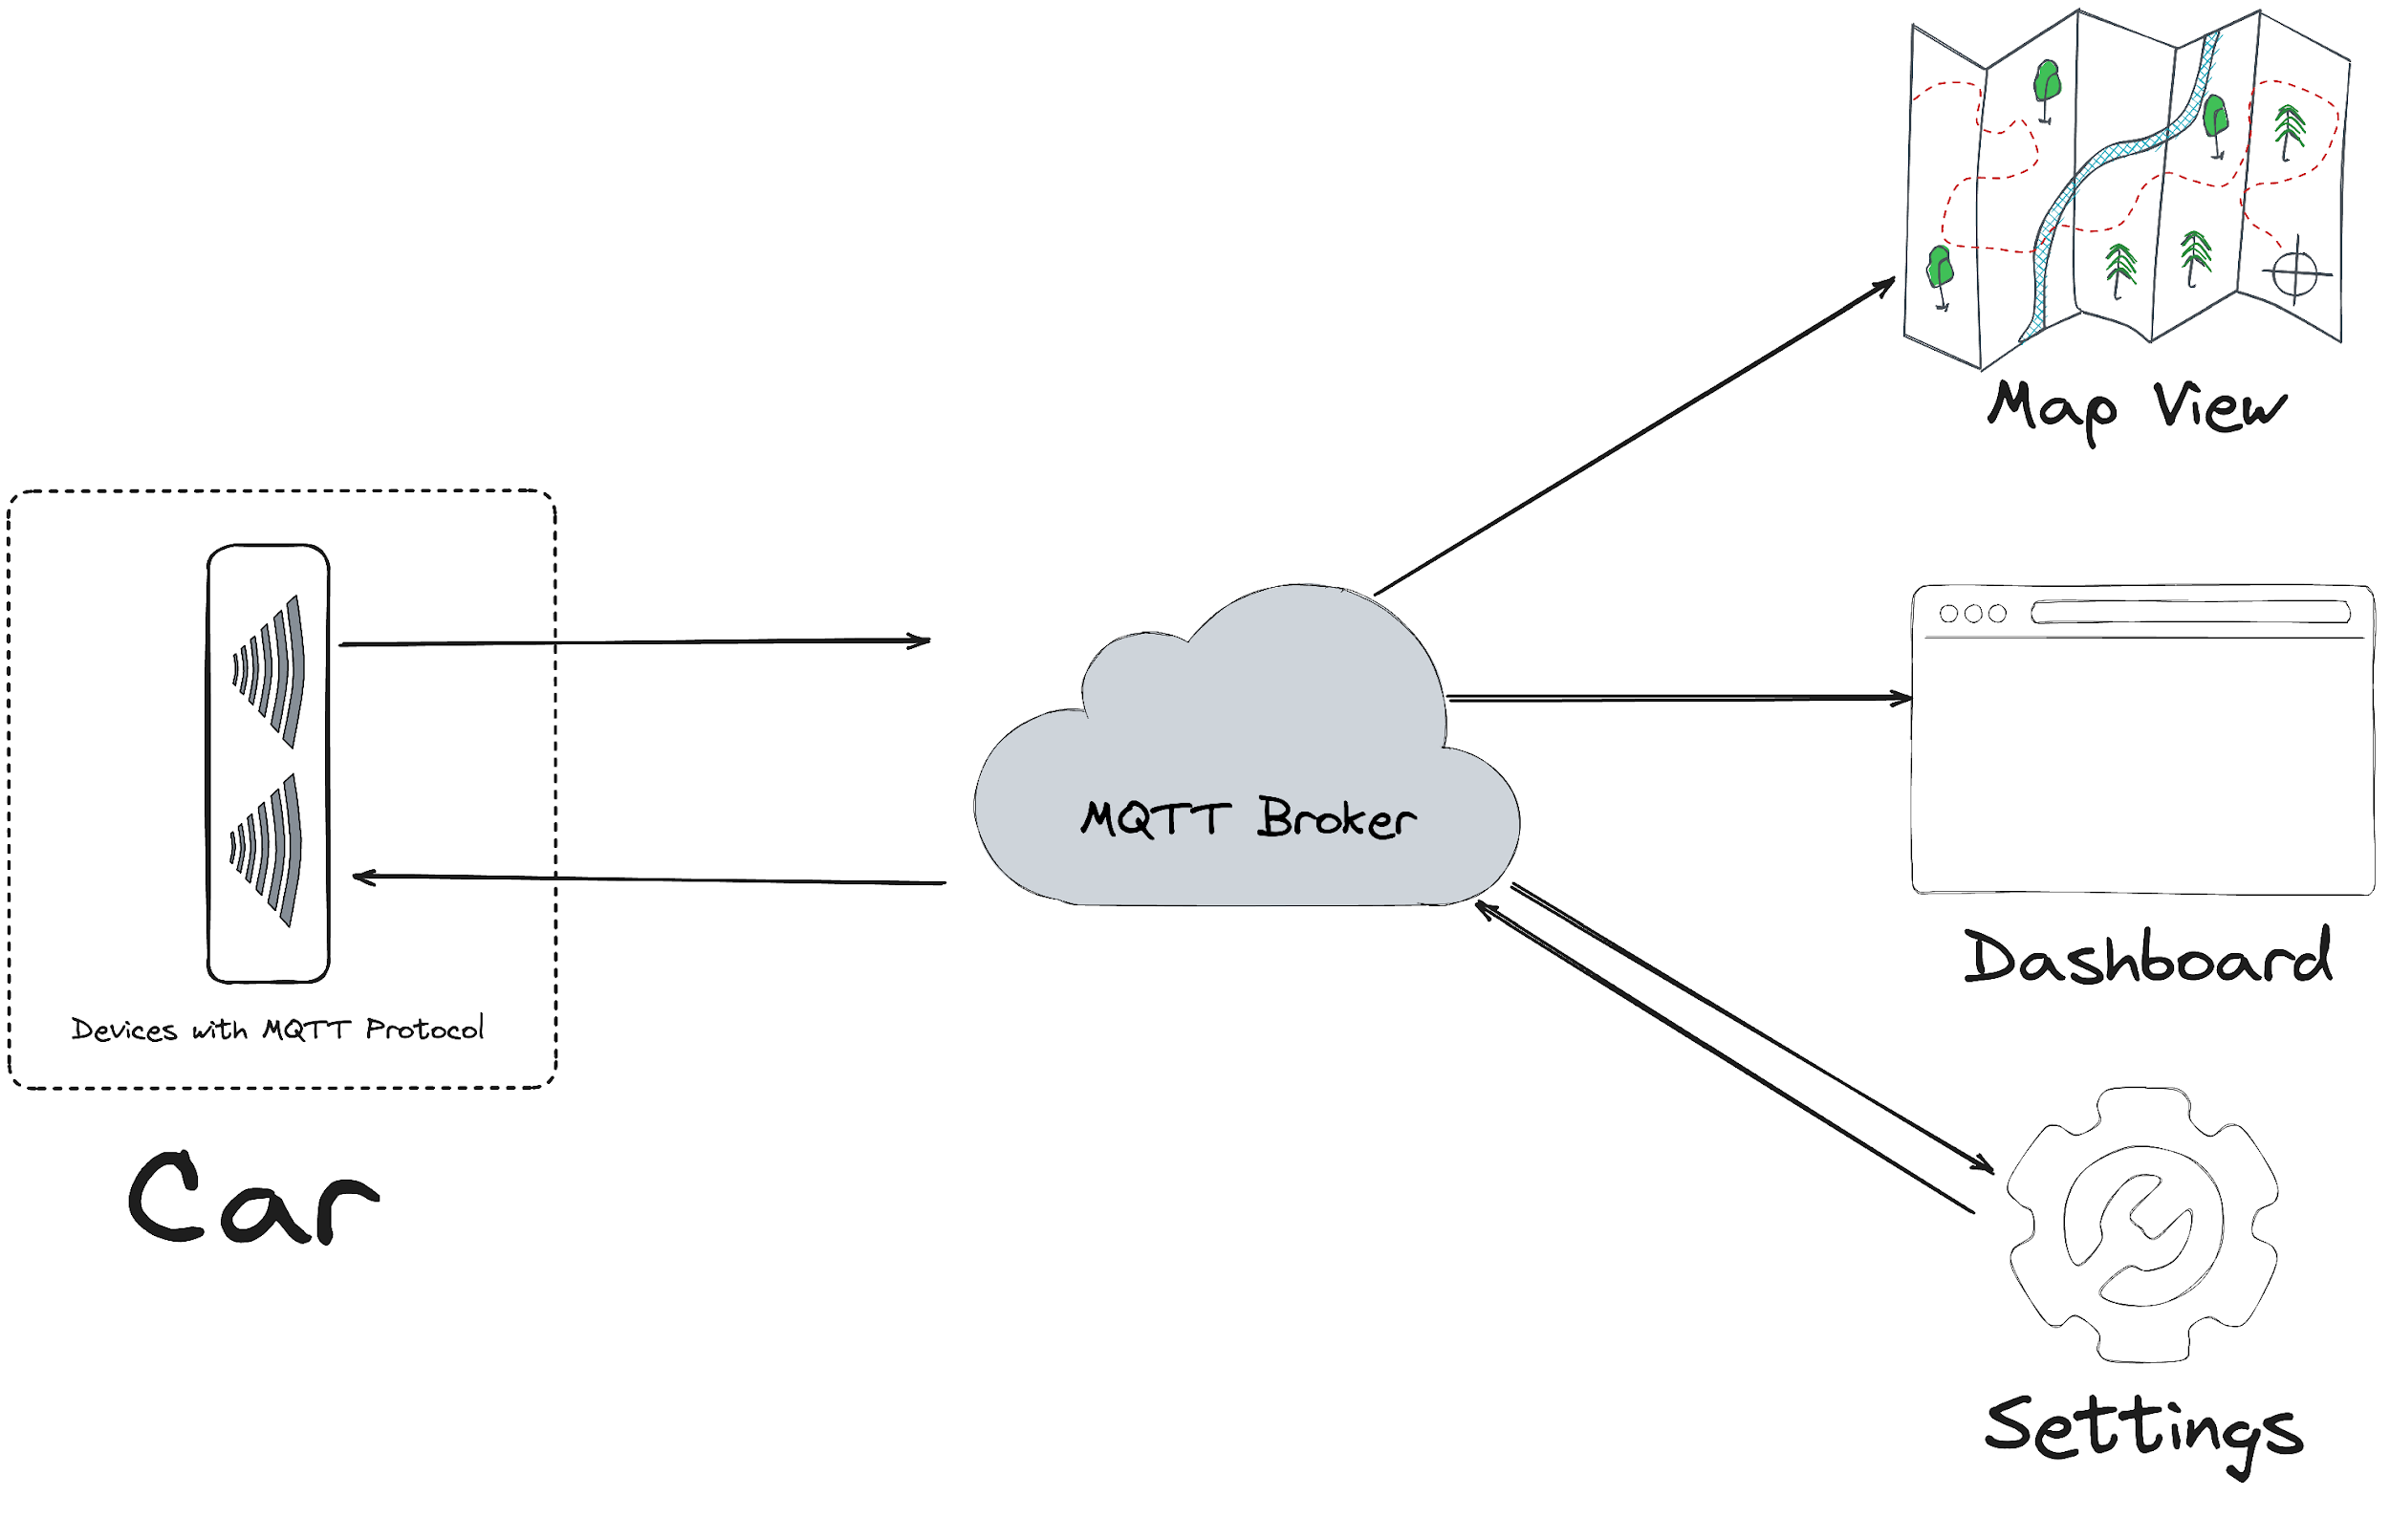
d
Client

Slide 35

Go

Slide 36
Go and MQTT
Powerful Alliance
Go's efficiency and low resource requirements make it ideal for resource-constrained devices.

Slide 37
Implementation

Slide 38
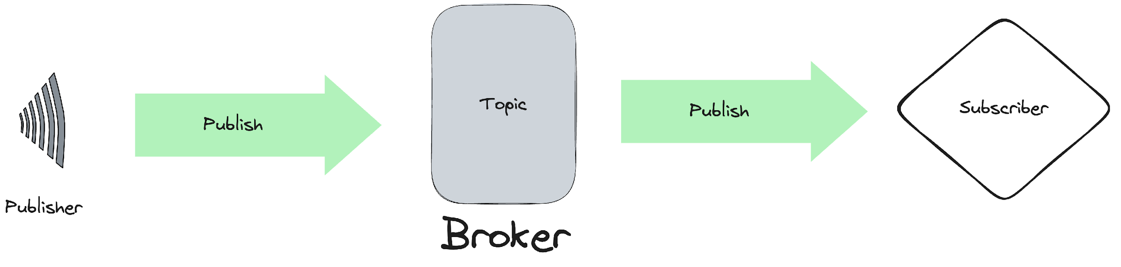
Simple Architecture
Subscribe

Slide 39
Go And MQTT
Prepare a Broker
Mosquitto
Others
Emitter
EMQ X
HiveMQ
AWS IoT Core
Free Public MQTT Broker

Slide 40

"Some dev have no problem making public test server their production"

Slide 41
Kenya Stats
1970 - 1980s: 170,000 Elephants
1979 - 1990: 16,000 Elephants | Ivory Demand
Current population: Approx 36,000 Elephants and other endangered species
Source KWS
36,000

Slide 42
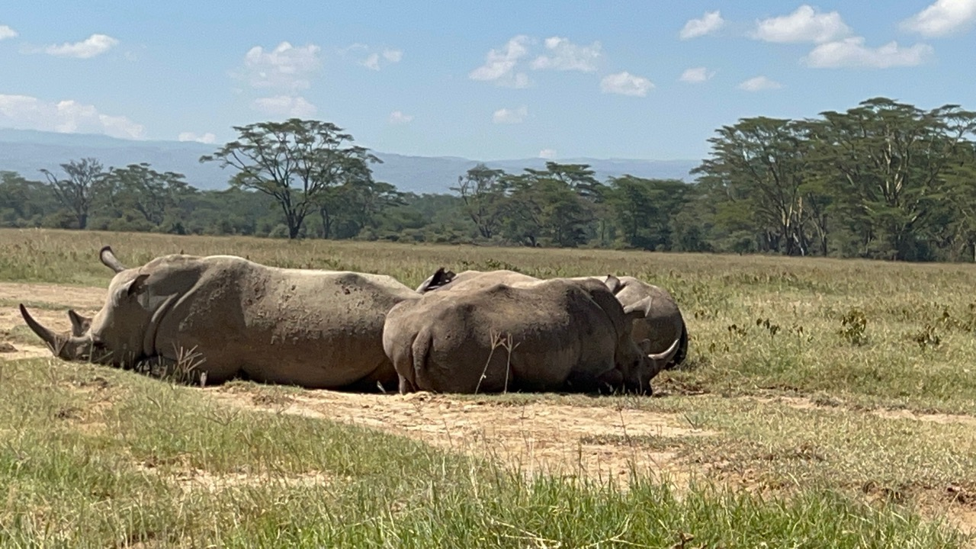

Slide 43
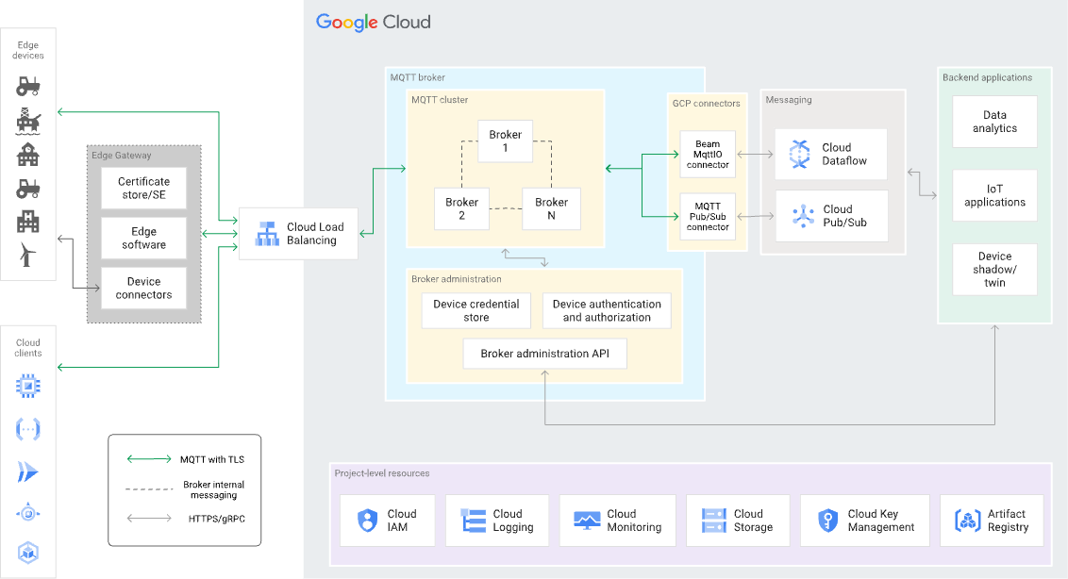
HA MQTT Architecture
credit google

Slide 44
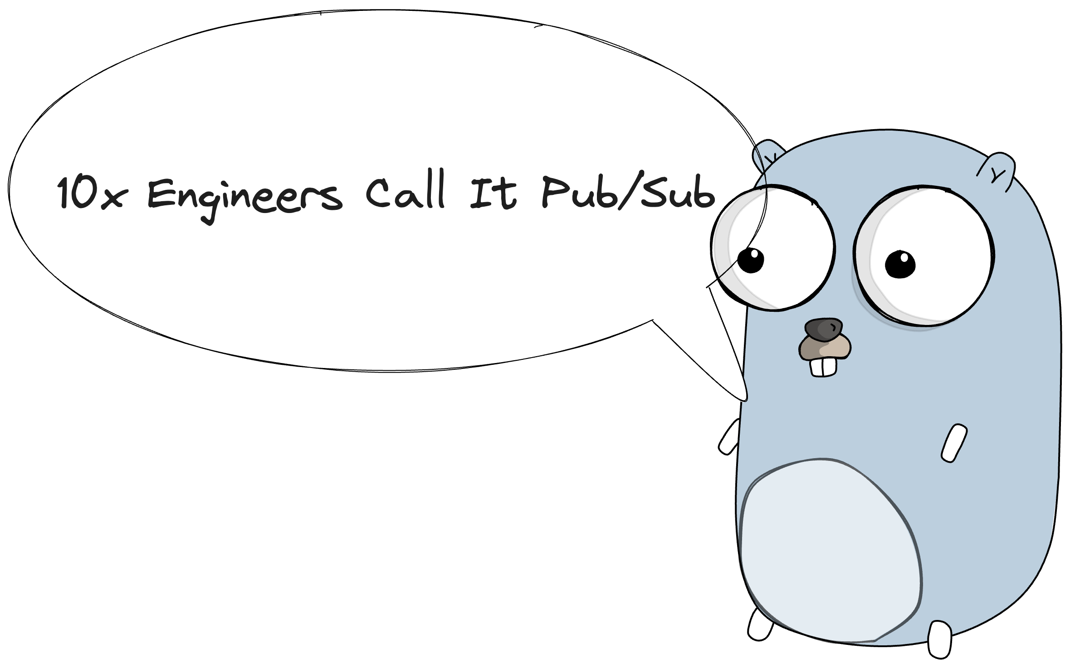
Publish/Subscribe Pattern
Publisher and Subscriber

Slide 45
Go and MQTT
Go MQTT Library
github.com/eclipse/paho.mqtt.golang MQTT v3
github.com/eclipse/paho.golang MQTT v5

Slide 46
Code

Slide 47
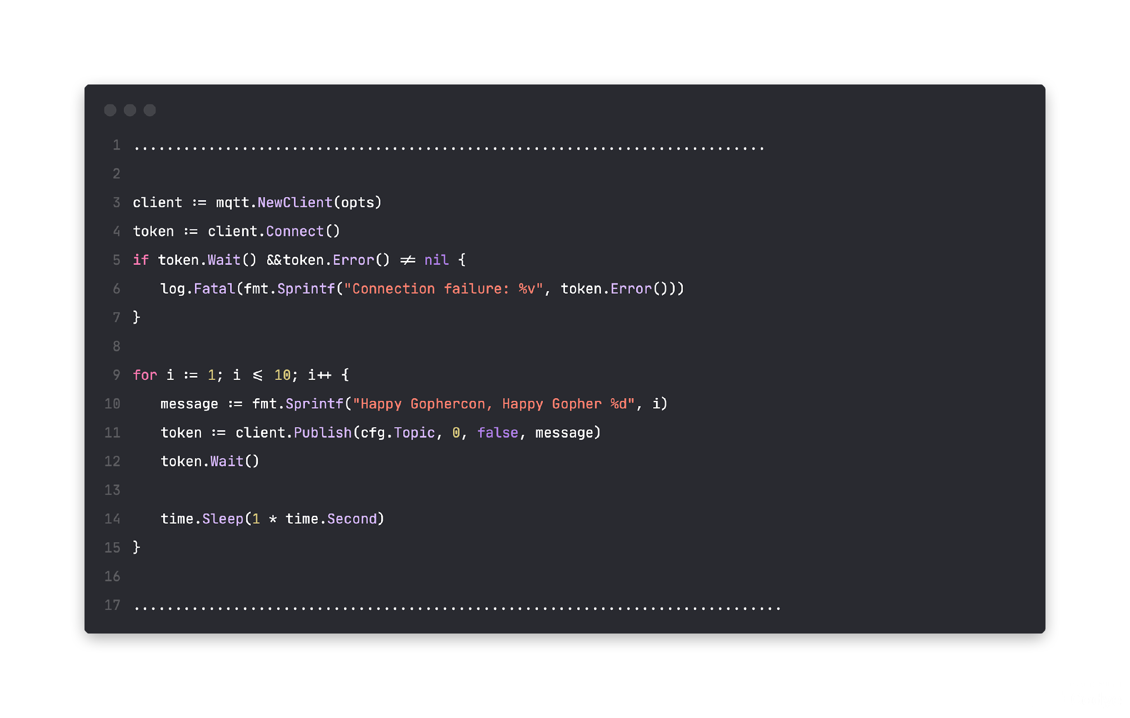
Publisher Example

Slide 48
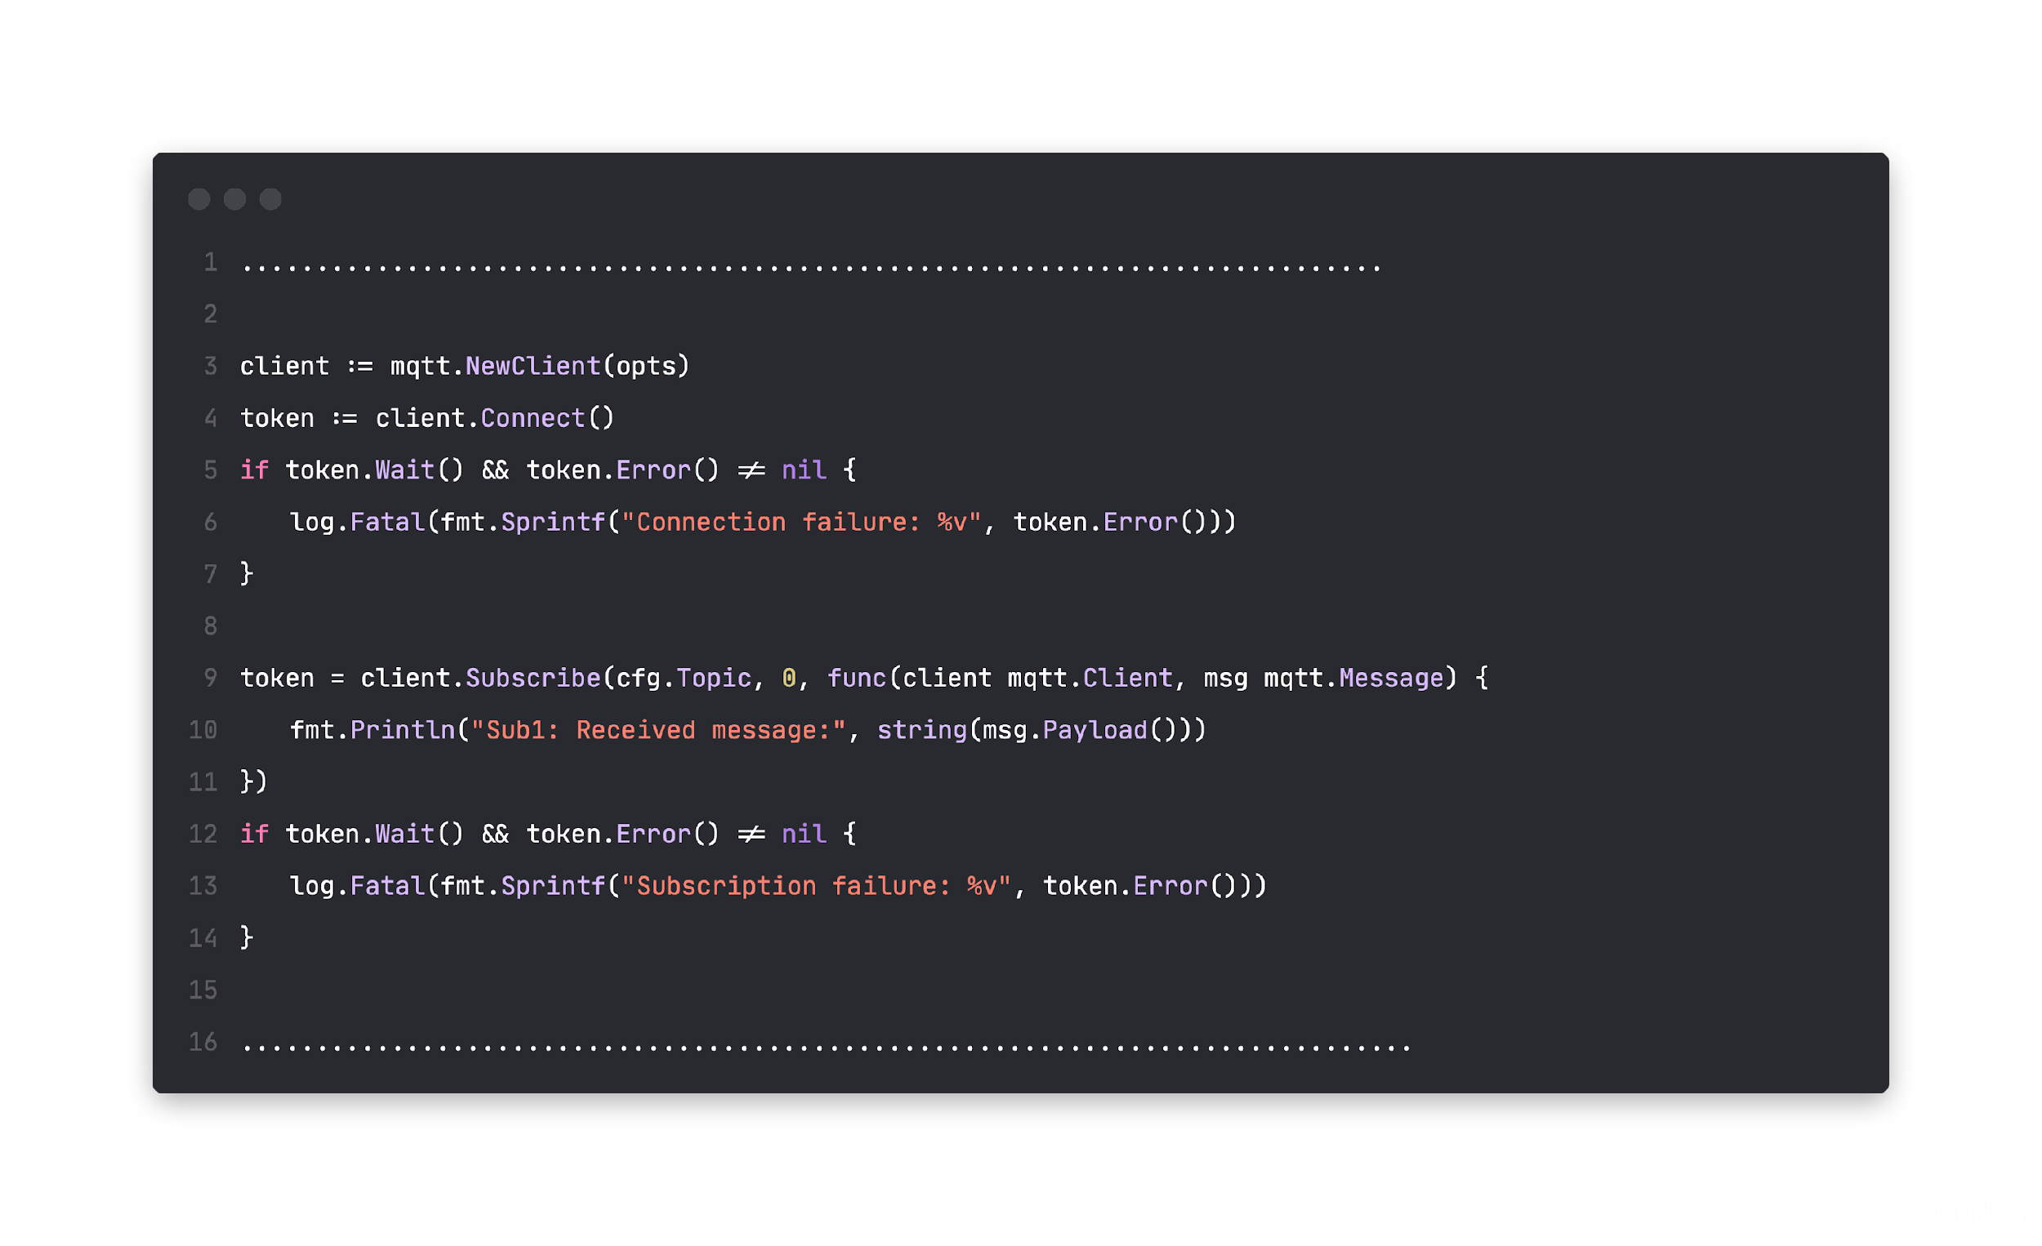
Subscriber Example

Slide 49


Slide 50
Disappointed!

Slide 51
Paho!
Indefinite I/O block
Failure to handle continues reconnection
Uses any for the payload
Excessively asynchronous API
Existing packages are hefty for most microcontrollers

Slide 52
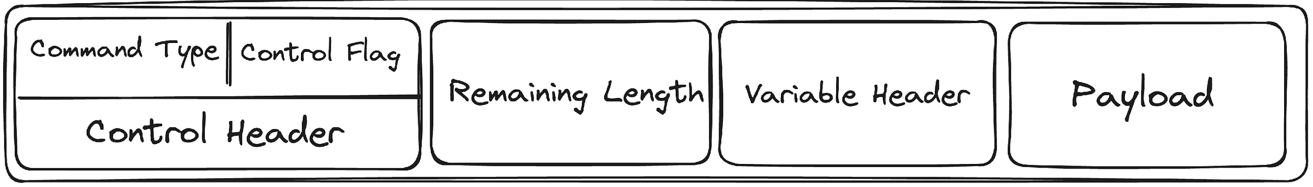
Let's Take a look at the MQTT packet
1 byte
1 - 4 byte
fixed header: 2 byte
x byte
y byte

Slide 53
Let's Take a look at the MQTT packet
Fixed header: Made up of the packet type, packet flags, and length of the remaining packet.

Slide 54
Let's Take a look at the MQTT packet
Variable header: The content and length of the variable header will vary according to the packet type and includes packet-type specific meta-data

Slide 55
Let's Take a look at the MQTT packet
Payload: The packet-type specific payload data

Slide 56
Simple
Go implementation
of CONNECT command

Slide 57
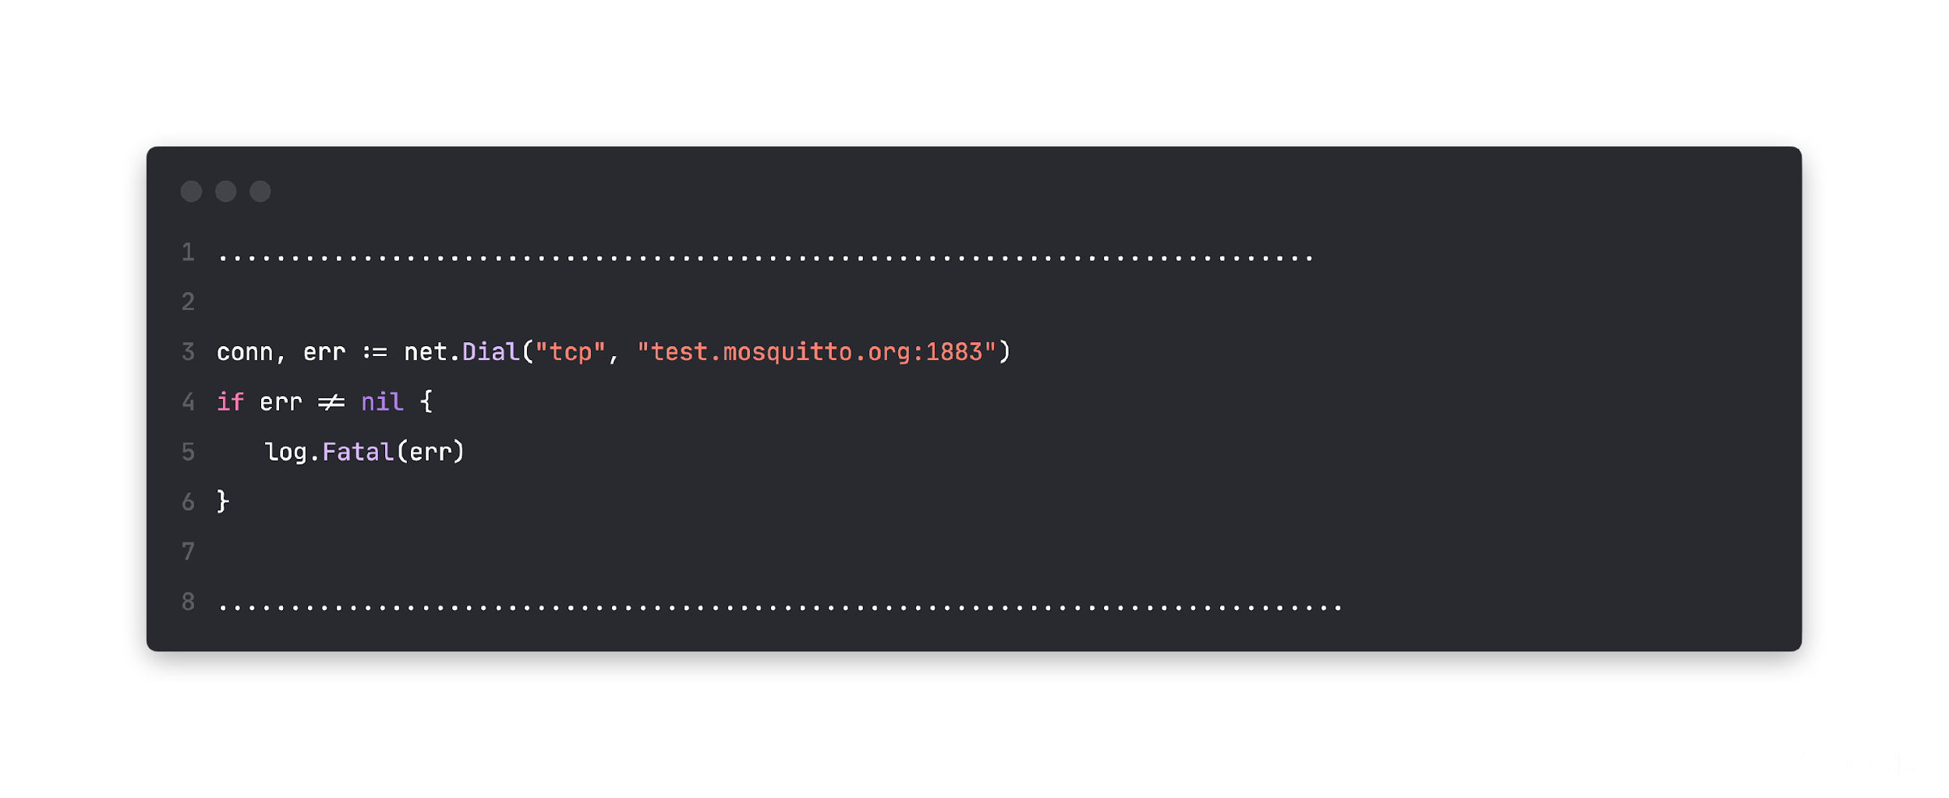
TCP connection to the MQTT broker

Slide 58
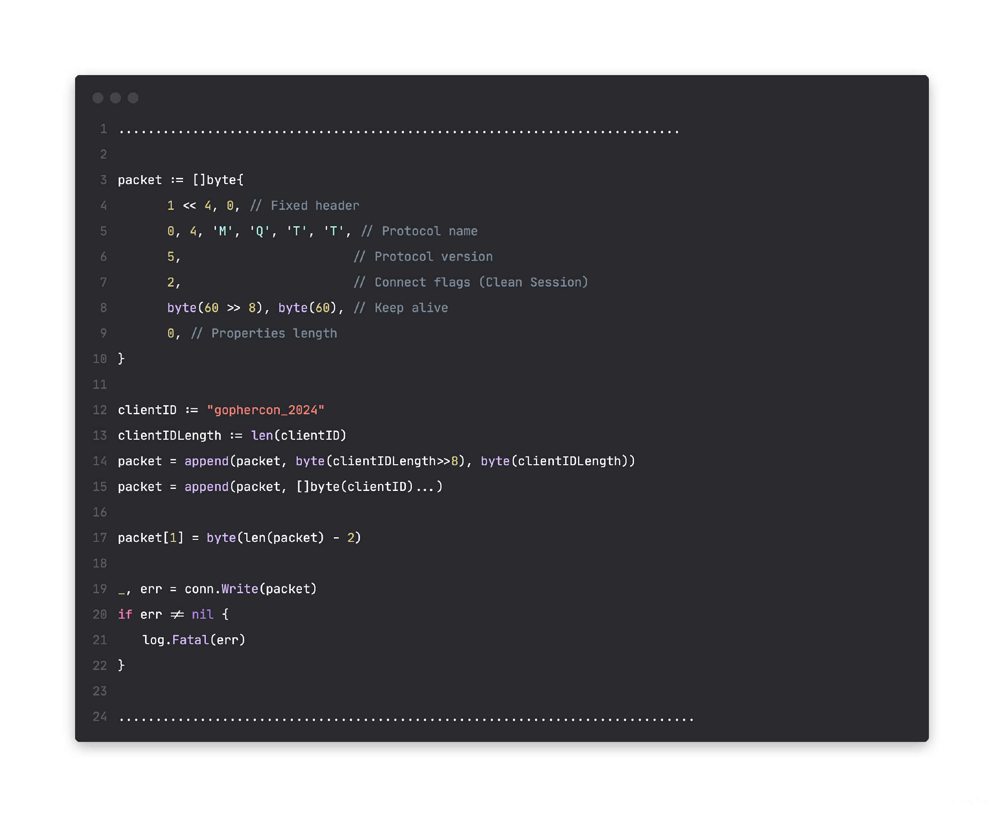
Constructs the MQTT CONNECT packet and sends it to the broker.

Slide 59
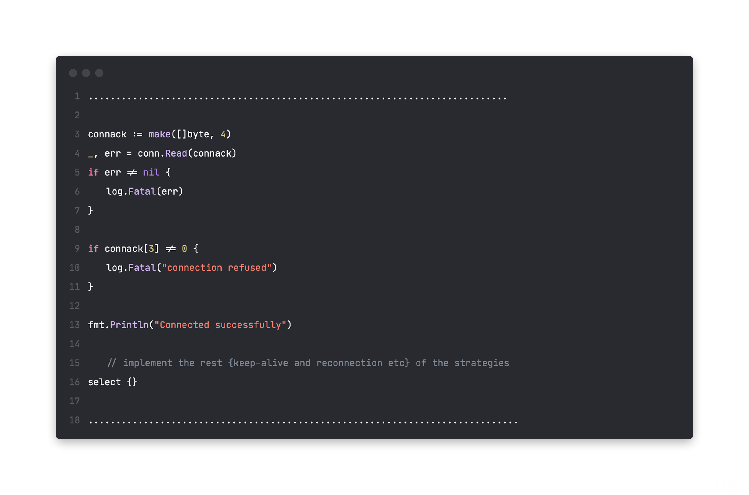
Reads the CONNACK packet from the broker.

Slide 60
Many moons and cup of coffees later…
Demo

Slide 61
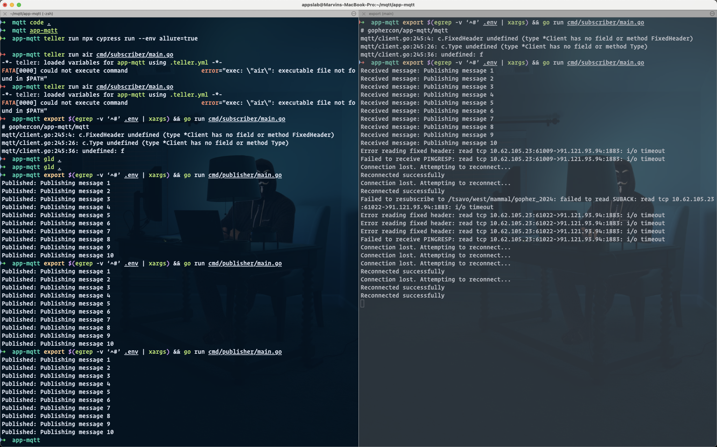

Slide 62
What is working ATM
Animal tagging devices programmed with TinyGo and is being developed on Arduino nano 33 IoT
Animal Location tracking and health monitor stats shared with MQTT
The trial phase was completed with much success.

Slide 63
"Last Will"

Slide 64
Thank you, asante …

